Slide 1
Unsupervised Learning
CS3300 Data Science
RJ Nowling

Slide 2
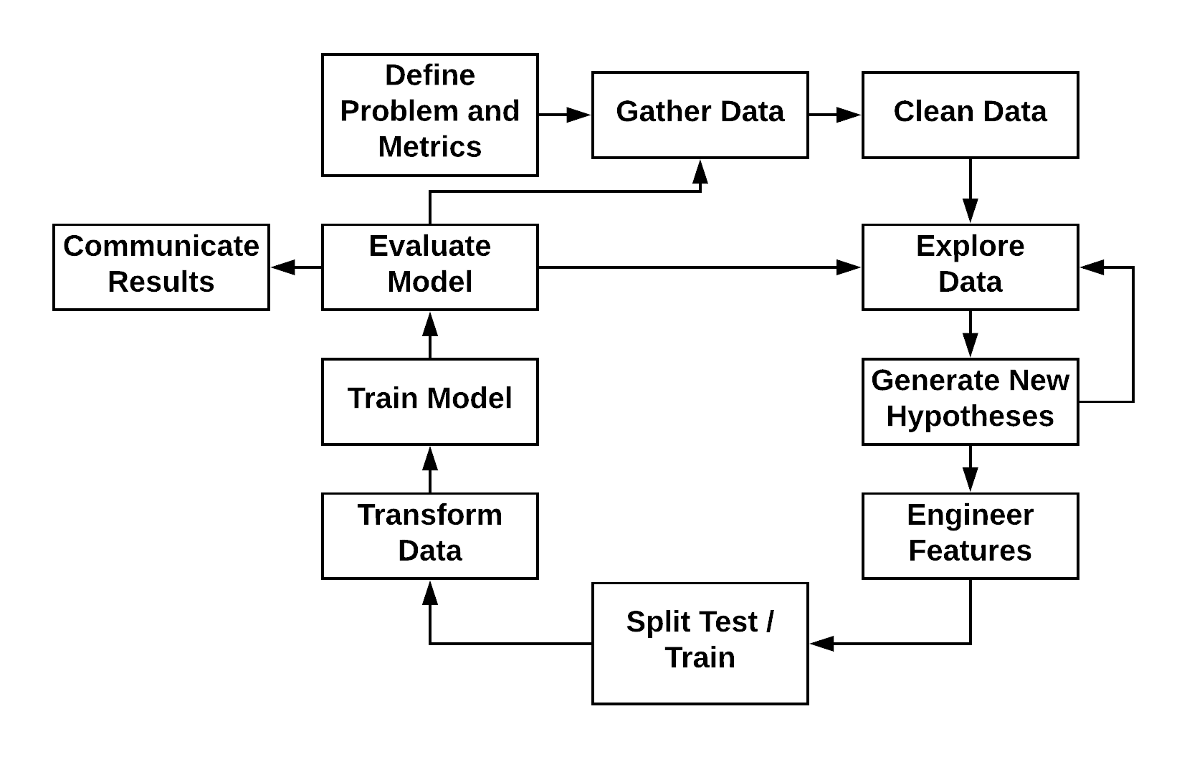
Machine Learning Process

Slide 3
Readings
Sections 8.3-8.5
Section 10.5

Slide 4
What is Data Science?
Extract actionable knowledge from data
Relies heavily on domain knowledge
Two modes:
Given a problem, what data is available to answer it?
Given a data set, what interesting problems can we apply to it?
Application of the scientific method to data
Exploring data to generate hypotheses (exploratory data analysis)
Evaluating hypotheses with visualizations, predictive models, and statistics
Either communicating those hypotheses and evidence to others OR using that knowledge to build a machine learning-powered system

Slide 5
Exploratory Data Analysis
Search for patterns and trends in a given data set
Largely visual
Sanity check
Identify mistakes in collection / processing
Finding violations of statistical assumptions
Generate hypotheses

Slide 6
Advertising Infrastructure Case Study
AdRoll is an online advertising platform
AdRoll uses user data (e.g., web pages viewed) from your web site to determine which ads to show users and how much to pay for those ads
One part of AdRoll’s system is a recommendation system – used to generate candidate ads for a user which are refined by another system further down the pipeline
Recommendations generated for 1 billion cookies per day by a batch job

Slide 7
AdRoll Infrastructure Case Study
Or "why am I getting a paged in the middle of the night saying that our machine learning pipeline hasn't completed on schedule?"
(More profanities in real life…)

Slide 8
Problem
Monitor pipeline completion times
Pipeline run times going up
Potential they won't complete in desired period
More data -> longer run time
More data -> higher infrastructure costs (e.g., more EC2 instances and higher S3 storage costs)

Slide 9
Data Collection
Customers inject code into their web site to allow AdRoll to track visitors' page views
Record every ad impression and click

Slide 10
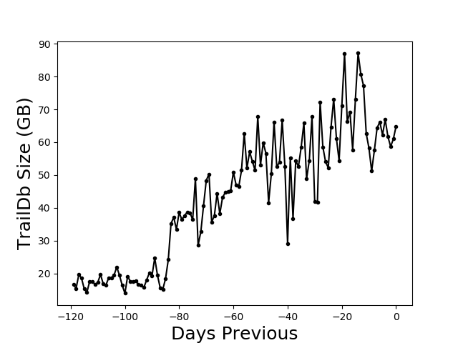
Daily Data Size Over Last 120 Days

Slide 11
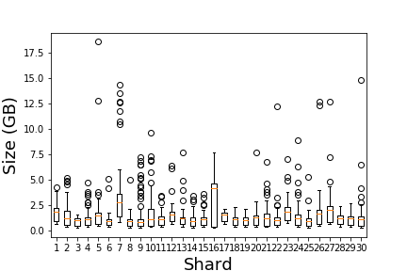
Daily Size Distributions by Shard

Slide 12
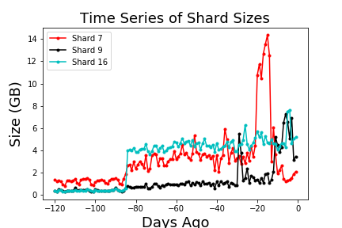
Time Series of Chosen Shards

Slide 13
Action Items
Duplicate data during data model transition
Wait until transition is complete
Mobile advertiser data
Filter out data
Highly-redundant user attribute data from third party vendor
Short term: Filter out third-party user attribute data
Medium term: Implement lightweight monitoring and alerting system that checks properties of the data over time
Longer term: De-duplicate data and make available as source for feature engineering

Slide 14
Exploratory Data Analysis Approaches
Plot distributions of a single variable
Plot relationships between pairs of variables
Scatter
Joint density
Box plot
Break down data by certain dimensions (e.g., gender, location) and look for differences by group

Slide 15
High-Dimensional Data
Data with more than low 10's of dimensions (variables)
Cannot analyze individual variables by hand
Examples
Text data
Genomic data
Clickstream (user-product interaction) data
Need other approaches

Slide 16
Unsupervised Learning
Unsupervised learning is when we have no outcome variable or labels, only a feature matrix
Broadly divided into two types:
Dimensionality Reduction
Clustering
Great for exploratory data analysis of high-dimensional data

Slide 17
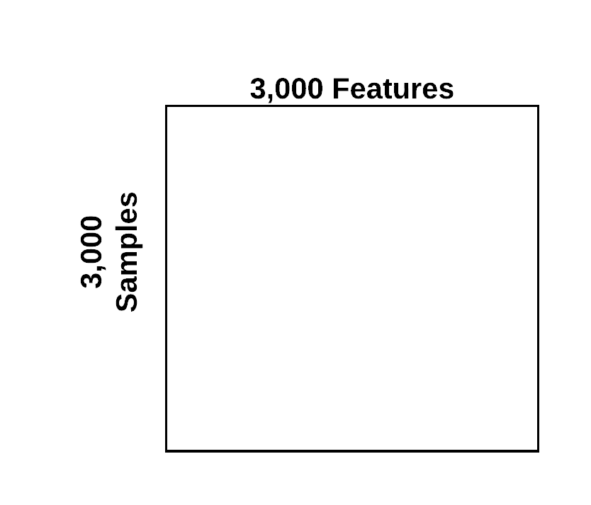
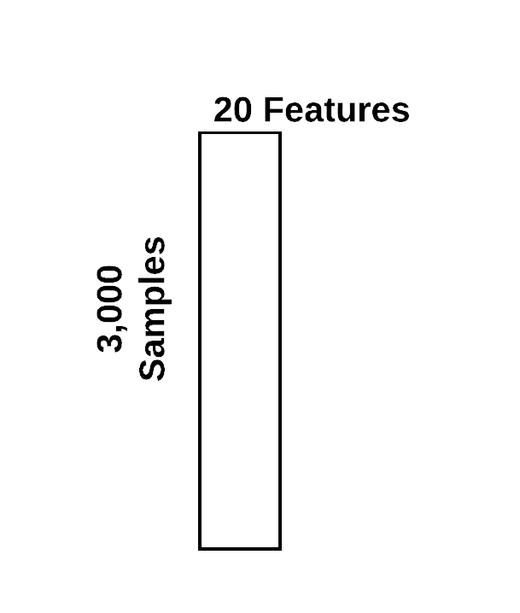
Dimensionality Reduction

Slide 18
Approaches for Dimensionality Reduction
(Linear) Matrix Factorization Methods
Principal Component Analysis (PCA)
Non-Negative Matrix Factorization (NMF)
t-Distributed Stochastic Neighbor Embedding (t-SNE)
Uniform Manifold Approximate Projection (UMAP)
Variational Auto-Encoders (VAEs)

Slide 19
Principal Component Analysis (PCA)
Identifiers clusters of correlated variables
Replaces each cluster with a single variable (principal component)
The components are orthogonal and form a new coordinate system
Approximate factorization of the feature matrix X ≅ T W^{T} T = XW X is n x p, W is p x l, T is n x l

Slide 20
Principal Component Analysis (PCA)
Compute a covariance matrix (X^{T}X)
Diagonalize covariance matrix to get eigenvectors and eigenvalues
Eigenvectors are the principal components
Eigenvalues give you the explained variance of each component
In reality, we don't do this:
Covariance matrix will be very large
We use randomized algorithms or SVD to avoid computing the covariance matrix
Good libraries (e.g., scikit-learn) should provide implementations

Slide 21
Anopheles Mosquitoes
Vectorbase.org / James Gathany

Slide 22
What is an Inversion?
Notes:
Karyotype map from Maria – "gambiae karyotype map"

Slide 23
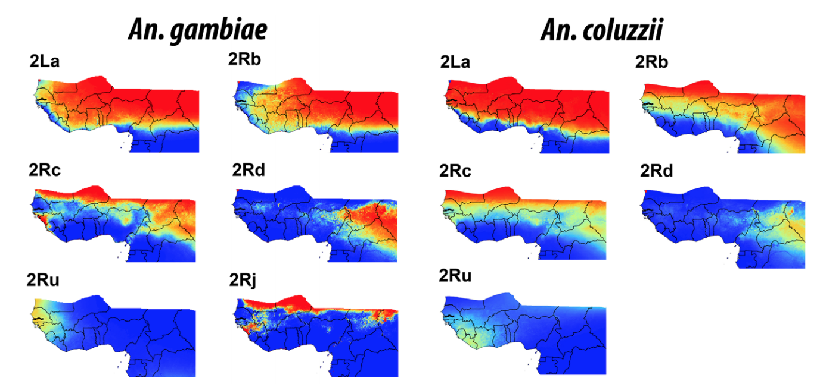
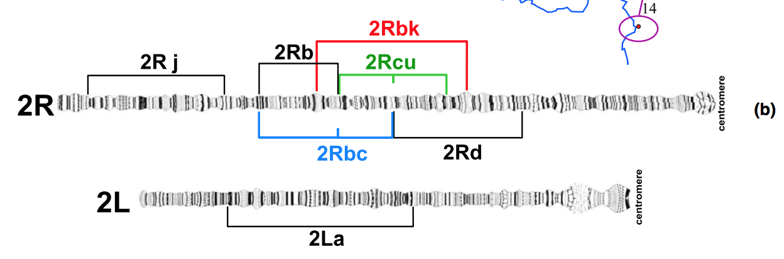
Inversions
Ayala, et al. Evolution. 2017; Caputo, et al. Mol. Ecology. 2014.

Slide 24
Importance of Inversions
Thought to play an important role in ecological adaptation by enabling the accumulation of beneficial alleles Fuller, et al. Bioarxiv. 2017.; Love, et al. Mol. Ecol. 2016.
2La in Anopheles gambiae
Thermal tolerance of larvae Rocca, et al. Malaria Journal. 2009.
Enhanced desiccation resistance Gray, et al. Malaria Journal. 2009.
Susceptibility to malaria parasite species Riehle, Elife. 2016.
Notes:
reduced recombination

Slide 25
Single Nucleotide Polymorphisms (SNPs)
An. gambiae | ATGCATGCATTCATGC
An. gambiae | ATGCATCCATACATGC
An. gambiae | ATGCATGCATTCATGC
An. gambiae | ATGCATCCATACATGC
An. coluzzii | AAGCATGCATTCATGC
An. coluzzii | AAGCATGCATACATGC
An. coluzzii | AAGCATGCATTCATGC
An. coluzzii | AAGCATGCATACATGC

Slide 26
Single Nucleotide Polymorphisms (SNPs)
An. gambiae | T G T
An. gambiae | T C A
An. gambiae | T G T
An. gambiae | T C A
An. coluzzii | A G T
An. coluzzii | A G A
An. coluzzii | A G T
An. coluzzii | A G A

Slide 27
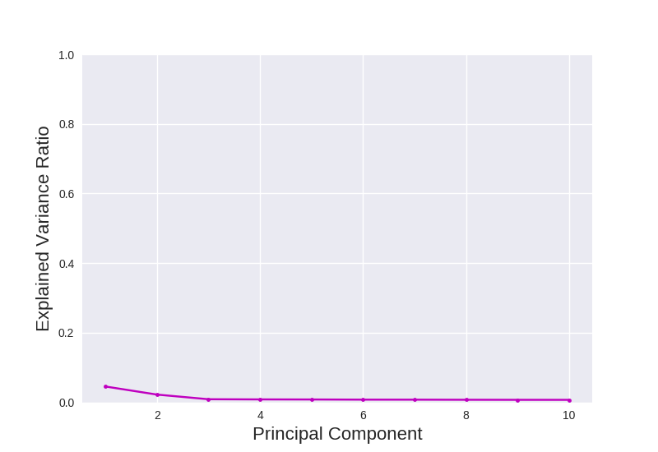
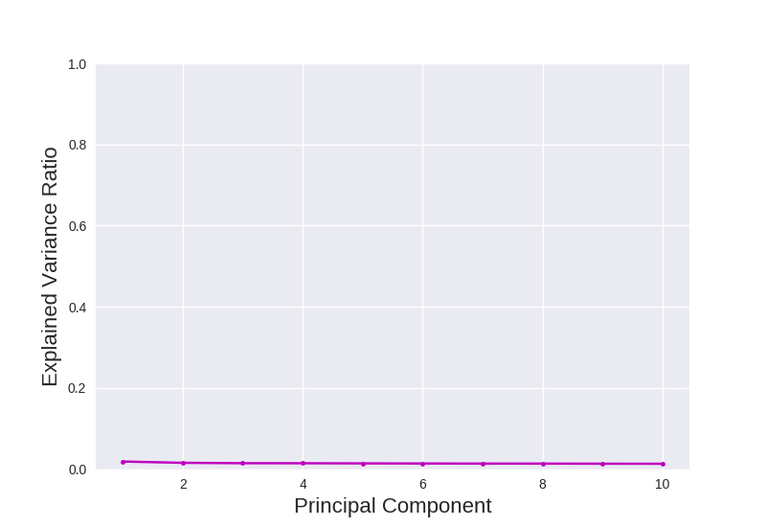
Picking Number of Components

Slide 28
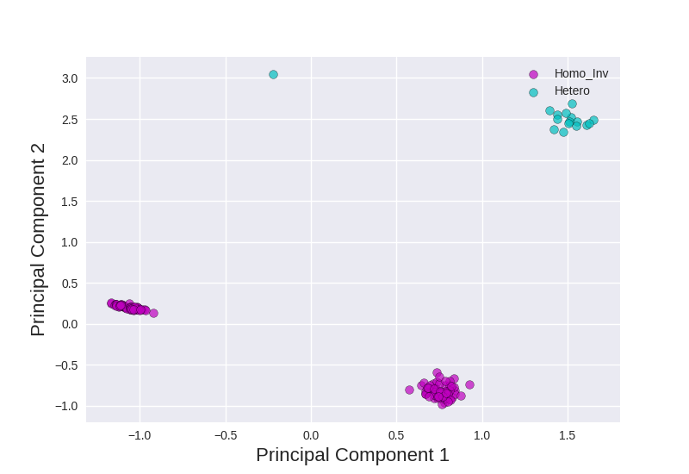
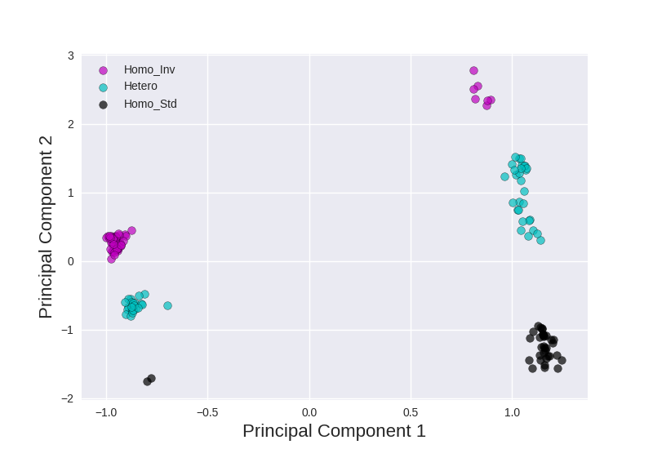
PCA of Anopheles Mosquitoes

Slide 29
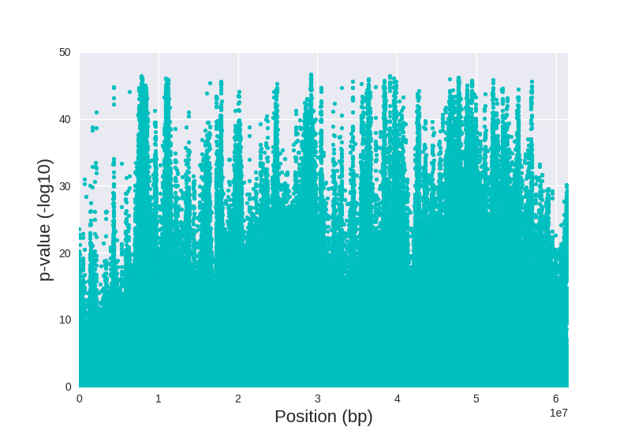
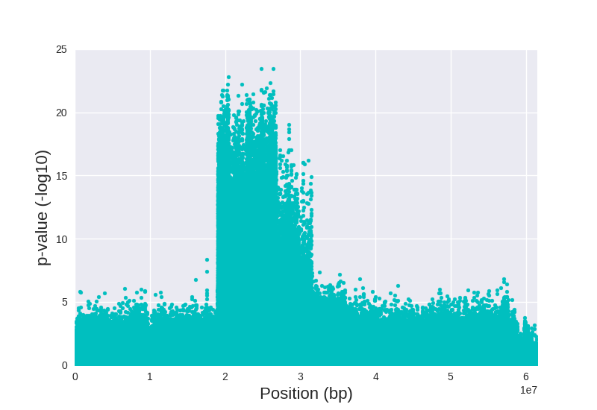
PC-SNP Associations on Anopheles 2R

Slide 30
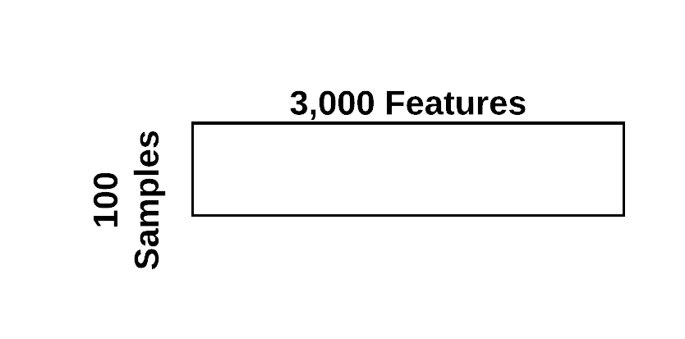
Clustering

Slide 31
Algorithms
K-Means, Mini-Batch K-Means
K-Medoids
Hierarchical Clustering
Gaussian Mixture Models (GMMs)

Slide 32
K-Means
Each cluster is represented by a "cluster center"
Midpoint of all points assigned to the cluster
Iterative
Assign each point to a cluster by finding the closest cluster center
Re-calculate the cluster centers by averaging the points in each cluster
Repeat until either
cluster centers move less than a specified distance
maximum number of iterations

Slide 33
K-Means
Biased towards evenly-sized clusters
Sensitive to initialization:
Random: randomly choose k points to serve as initial centers
Kmeans++: try to choose points randomly based on their distances from each other
Local minimum
Edge Case

Slide 34
Picking k

Slide 35
Clusters - 6

Slide 36
Clusters - 8

Slide 37
Clusters - 10

Slide 38
Clusters - 11

Slide 39
Clustering High-Dimensional Data
Distance metrics used in clustering tend to fail in high dimensions
To cluster high-dimensional data:
We reduce the dimensionality using PCA or similar
Perform the clustering in the new (smaller) coordinate system

Slide 40
Data Set
trec07p – University of Waterloo
~ 75k emails from between April and July 2007
~25k ham
~50k spam
Used 75% for training, 25% for testing

Slide 41
Dear Class, I've uploaded the new homework to D2L. It's due on Monday. I'm looking forward to seeing your solutions! RJ
?
[0, 1, 0, 0, 0, 1, 1, 0, 0]

Slide 42
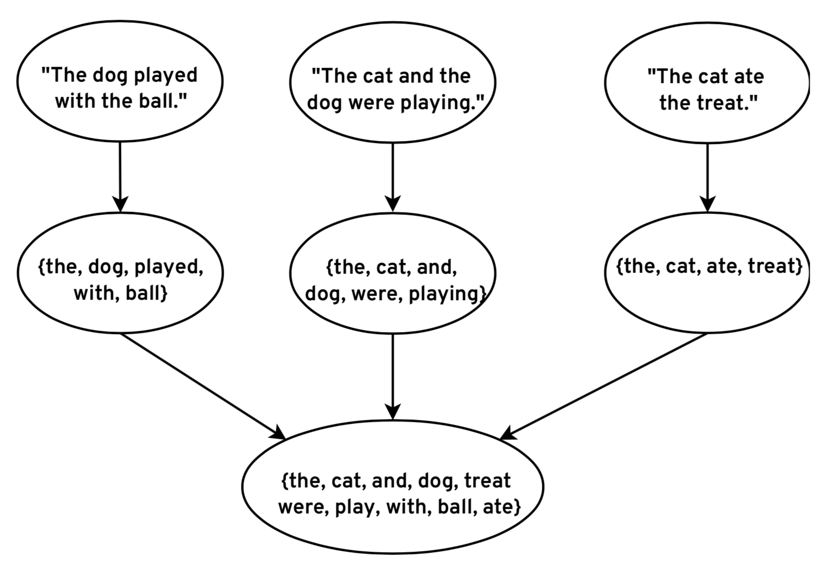
Extract Vocabulary

Slide 43
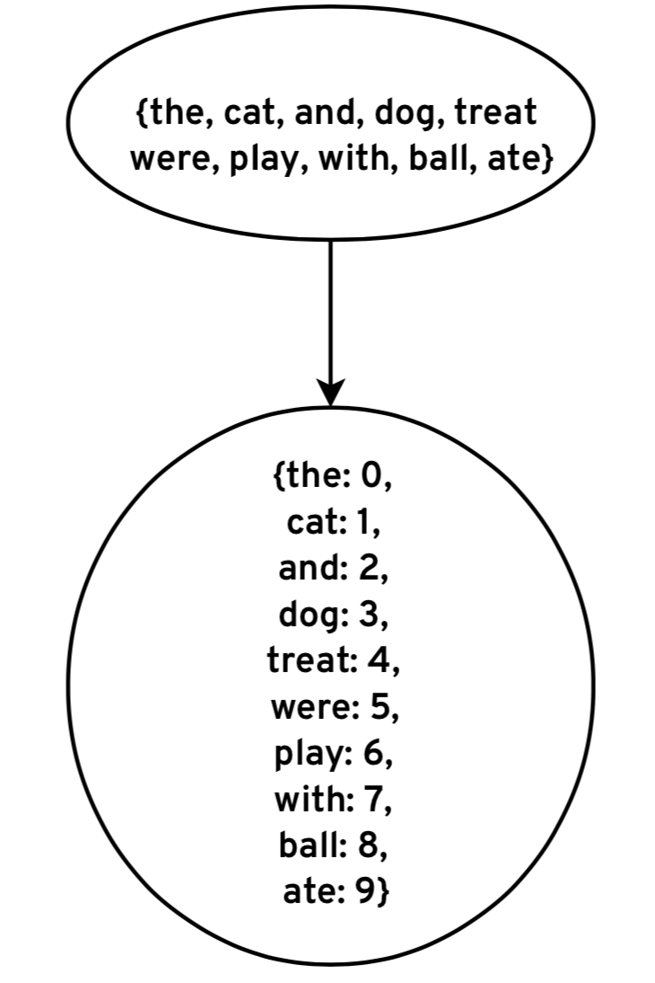
Map Words to Column Indices

Slide 44
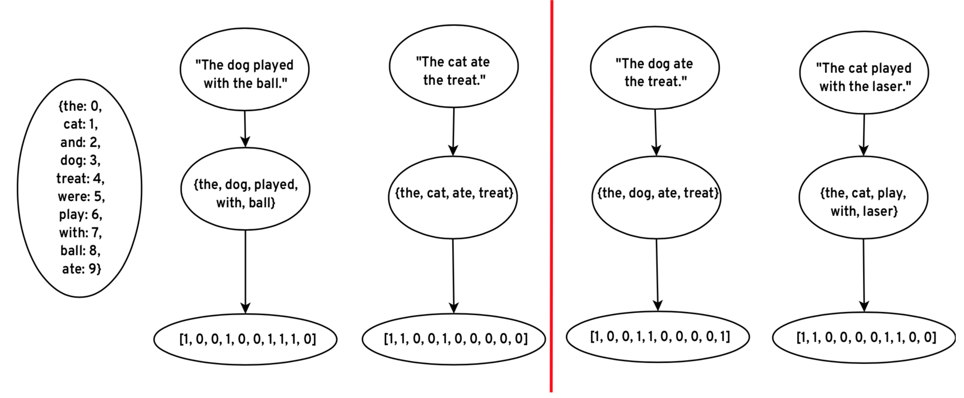
Encode Features

Slide 45
Encode Features

Slide 46
SVD – Explained Variance

Slide 47
SVD

Slide 48
Clustering - Inertia

Slide 49
Clustering

Slide 50
Clustering

Slide 51
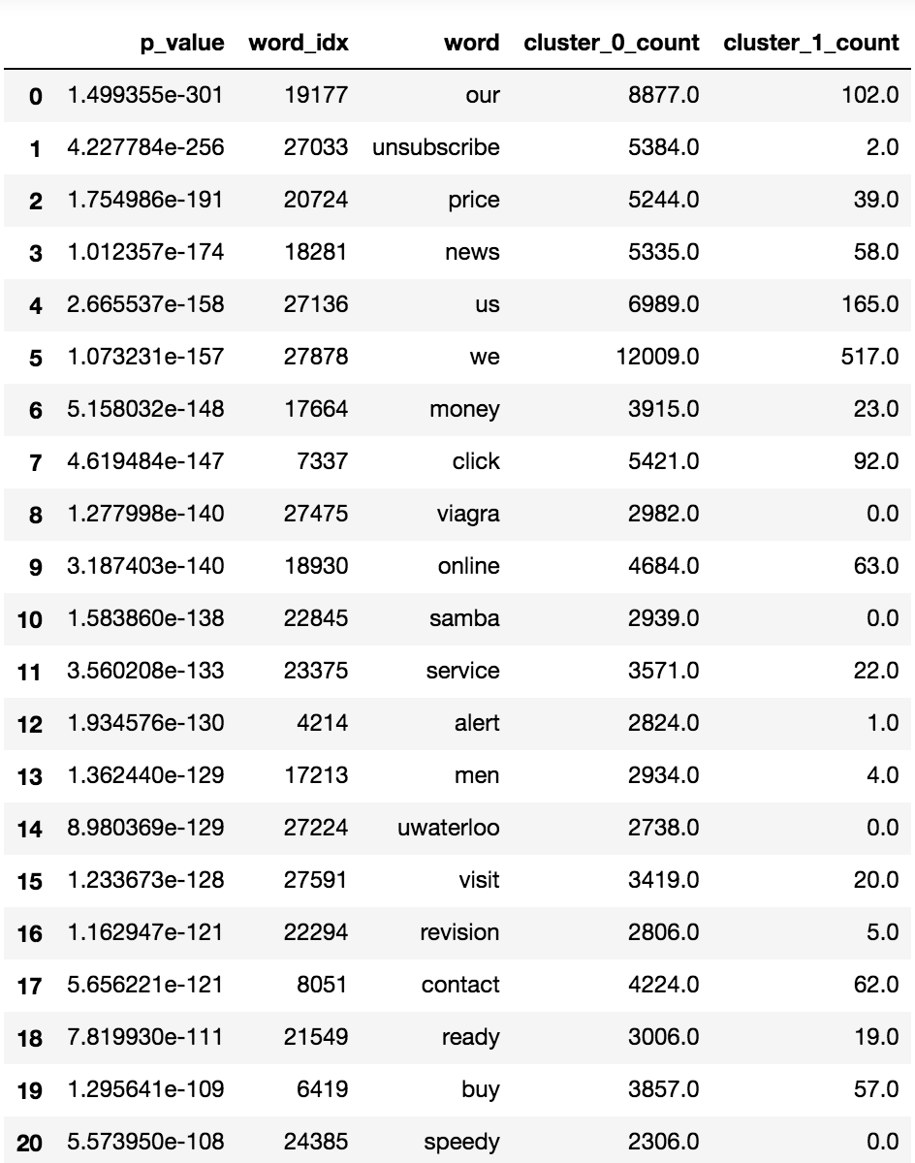
Association Tests Cluster 0

Slide 52
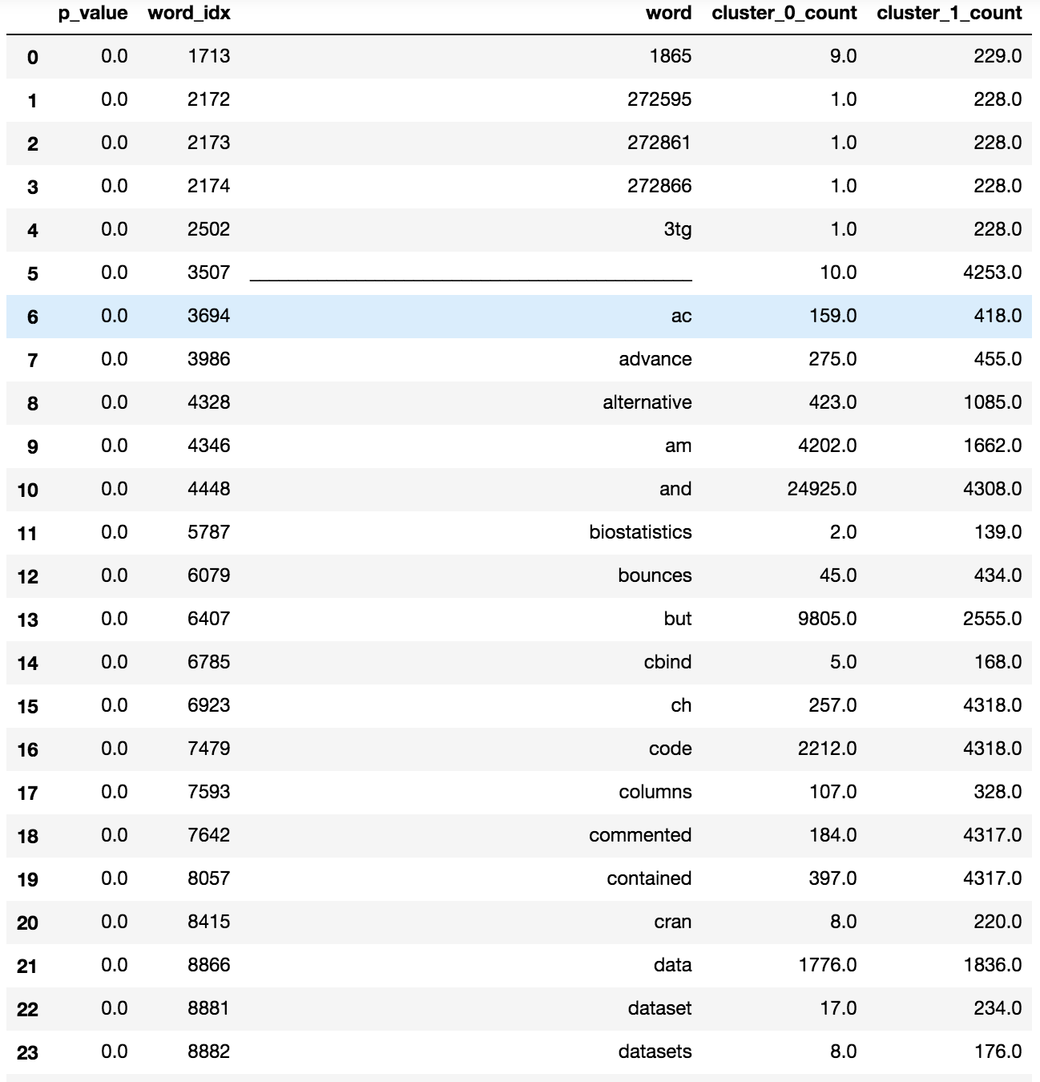
Association Tests Cluster 1

